Slide 1

ABC Call
Volume
Trend
Analysis
- Tanish

Slide 2

TABLE OF
CONTENTS
1. Project Description
2. Business Understanding
3. Tasks
4. Assumptions
5. Tech- Stack Used
6. Approach
7. Insights
8. Result
9. Conclusion
10.Drive Link

Slide 3
PROJECT
DESCRIPTION
A CX team analyzes customer feedback and data, sharing insights with the organization. They perform various roles, including CX programs, digital customer experience, design, internal communications, voice of the customer, user experiences, journey mapping, customer success, customer support, data handling, and learning about the customer
journey.
AI-empowered customer experience tools, such as IVR, RPA, predictive analytics, and intelligent routing, can significantly impact customer service. The Customer Experience team offers numerous employment opportunities for customer service representatives, including email,
inbound, outbound, and social media support. Inbound customer support involves handling incoming calls from existing or prospective customers, attracting, engaging, and delighting them to become loyal advocates. By solving customer problems and helping them achieve success, businesses can delight customers and grow their business.

Slide 4
BUSINESS
UNDERSTANDING
Advertising is a marketing strategy used to
increase sales and raise awareness of a business’s products or services. It helps form first impressions of a customer before they make a purchase. Businesses can target various audiences, including local, regional, national, or international, using various methods such as internet directories, trade press, radio, cinema, outdoor advertising, national papers, magazines, and TV. The advertising industry
is highly competitive, with many players bidding
heavily for the same audience. Companies must use their analytical skills to effectively target these audiences across various media platforms, converting them into customers at a low cost.

Slide 5
TASKS
• Calculate the average call time duration for all incoming calls received by agents (in each Time_Bucket).
• Show the total volume/ number of calls coming in via charts/graphs [Number of calls v/s Time]. You can select time in a bucket form (i.e.,1-2,2-3 ..…)
• As you can see current abandon rate is approximately 30%.Propose a manpower plan required during each time bucket [between 9am to 9pm] to reduce the abandon rate to 10%. (i.e.,You must calculate minimum number of agents required in each time bucket so that at least 90 calls should be answered out of100.)
• Let’s say customers also call this ABC insurance company in night but didn’t get answer as there are no agents to answer, this creates a bad customer experience for this Insurance company. Suppose every 100 calls that customer made during 9 Am to 9 Pm, customer also made 30 calls in night between interval[9 Pm to 9 Am]Now propose a manpower plan required during each time bucket in a day. Maximum Abandon rate assumption would be same 10%.

Slide 6
ASSUMPTION
Name | Value
Agent working days per week | 6
Agent unplanned holidays per month | 4
Agent working hours per day | 9 hours
Agent lunch and snack time per day | 1.5 hours
Agent actual working hours per day | 7.5
Agent occupied in actual working hours per day | 60%
Average agent working time per day | 4.5 hours(16200 seconds)

Slide 7


TECH- STACK
USED
“MICROSOFT EXCEL”
VERSION:MICROSOFT 360
FOR CLEANING DATA,
ANALYZING DATA, etc.
“MICROSOFT POWER POINT”
VERSION:MICROSOFT 360
FOR CREATING THE REPORT

Slide 8
APPROACH
1. Dataset Familiarization
2. Data Cleaning
3. Data Analysis
4. Project Report

Slide 9




Dataset Familiarization: I started by downloading the provided data set and took the time to thoroughly understand the columns, descriptions, and requirements of the project. This helped me gain a better understanding of the data and set the foundation for my analysis.
Data Cleaning: To ensure accurate and meaningful analysis, I performed data cleaning. This involved removing unnecessary columns that were not relevant to the tasks at hand. By cleaning the data, I obtained a clean dataset that served as the basis for my analysis.
Data Analysis: Using Excel, I explored the data analysis part of the project. For each task, I utilized
pivot tables and graphs to perform the required calculations and generate insights. This allowed
me to extract valuable information and patterns from the data set.
Project Report: Once the data analysis was complete, I shifted my focus to creating the project
report. I opted to use PowerPoint for this purpose, where I could present my findings, insights, and
visualizations in a concise and visually appealing manner.

Slide 10
INSIGHTS
Average Call Time Duration: The highest average call duration was observed in the time buckets 10 to 11, 18 to 19, and 19 to 20, with an average duration of 203 seconds. On the other hand, the time bucket 12 to 13 had the lowest average call duration.
Number of Calls per Time Bucket: The time bucket 11 to 12 received the highest percentage of incoming calls, accounting for 12.4% of all calls. It was followed by the time bucket 10 to 11, which received 11.28% of the calls. Conversely, the time buckets 20 to 21 and 19 to 20 had the lowest call volumes, with percentages of 4.67% and 5.48%, respectively.
Manpower Plan to Reduce Abandonment Rate: In order to reduce the abandonment rate to 10%, it was determined that 79 unique agents would be required. Initially, when the abandonment rate was 30%, there were 66 unique agents working.
Night-time Call Volume and Agents required: It was observed that for every 100 calls made by customers during the 9:00 a.m. to 9:00 p.m. timeframe, there were also 30 calls made during the night from 9:00 p.m. to 9:00 a.m. To handle these night-time calls, a manpower of 22 unique agents would be needed.
Other Work Tasks: Apart from answering calls, agents need to allocate 27% of their total occupied time (27% of 4.5 hours) for uploading call data and other related tasks.
Full Effort Capacity: Agents have the capacity to take more calls than the estimated workload if they work with full effort, as they have additional time available.

Slide 11
RESULT

Slide 12
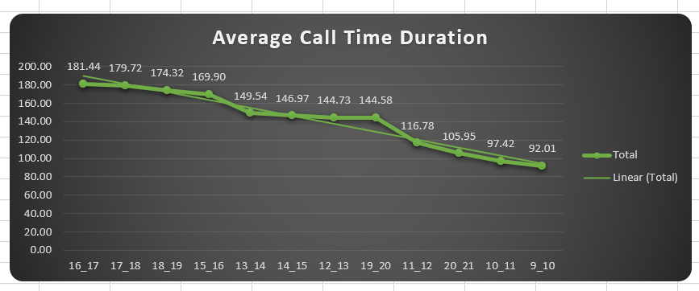
Average Call Time Duration

Slide 13
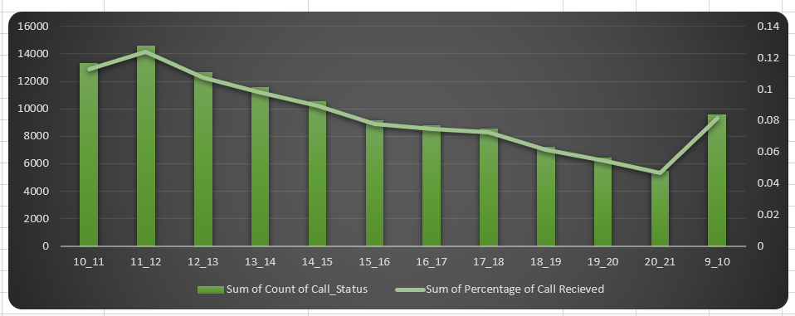
Number of Calls per Time Bucket

Slide 14
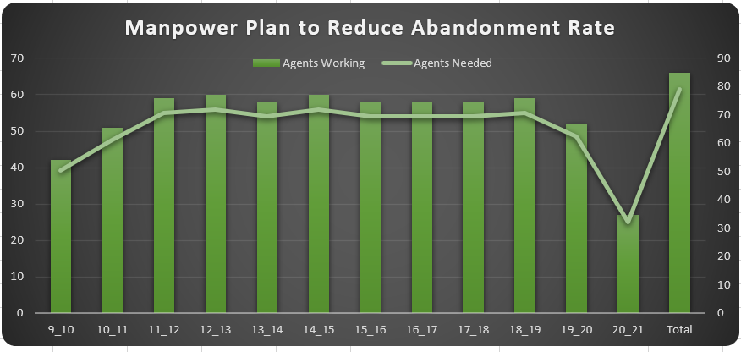
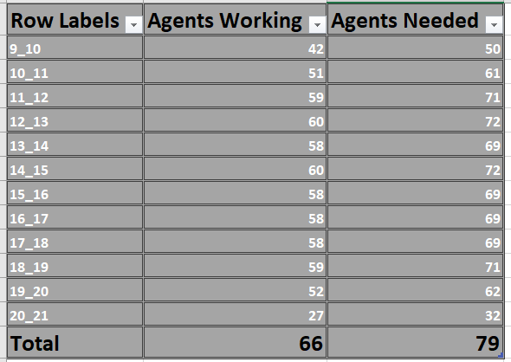
Manpower Plan to Reduce
Abandonment Rate

Slide 15
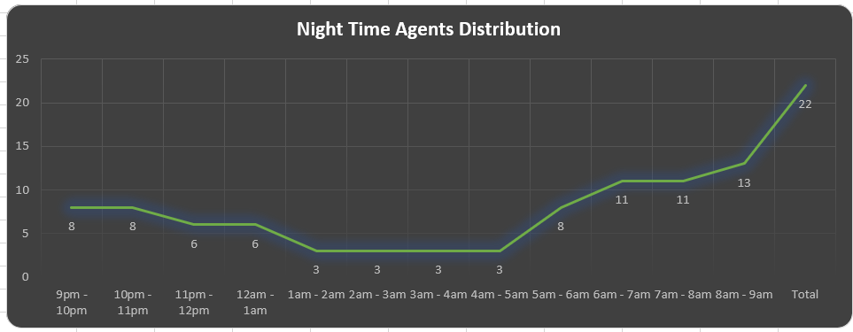
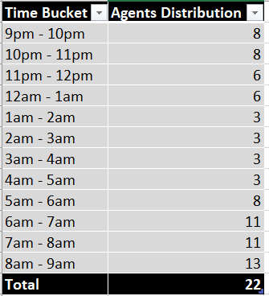
Night-time Call Volume
and Agents Required

Slide 16
Conclusion
In this project, I analyzed the dataset related to incoming calls received by agents and explored various aspects of agent performance and workload. I considered factors such as agent work schedule, unplanned leaves, working hours, occupied time on calls, and other work tasks.
Through our analysis, I found that the average call time duration varied across different time buckets, with some time periods experiencing longer call durations compared to others. Additionally, I observed the distribution of incoming calls across different time buckets, with certain time periods receiving a higher volume of calls.
To improve customer satisfaction and reduce the abandon rate, I proposed a manpower plan that aimed to ensure at least 90 calls are answered out of 100. Based on the current abandon rate and desired abandon rate, I also calculated the minimum number of agents required in each time bucket to achieve this goal.
Considering the agent's working hours, occupied time on calls, and other work tasks, I estimated the number of agents needed in each time bucket. I also factored in additional time for uploading call data and other related tasks. The proposed manpower plan suggested allocating enough agents in each time bucket to handle the workload effectively and reduce the abandon rate.
Furthermore, I highlighted the presence of calls during the night hours and determined the manpower required to handle those calls. I found that 22 unique agents were needed to handle the calls during the night hours.
Overall, this project provided valuable insights into agent performance, call distribution, and manpower planning. By implementing the proposed manpower plan, the organization can improve customer service, reduce the abandon rate, and ensure efficient utilization of agent resources.

Slide 17
Drive
Link
Link for Excel file:
https://docs.google.com/spreadsheets/d/1k9_dBibyUhN44ArDiwDl_7DjHeZgJ4SX/edit?usp=sharing&ouid=116128795062416707309&rtpof=true&sd=true

Slide 18


